Slide 1
Fundamentals of TRIAC and DIAC

Slide 2
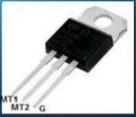
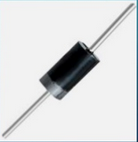
Introduction
Diode for Alternating Current (DIAC)
Triode for Alternating Current (TRIAC)
These are special semiconductor devices

Slide 3
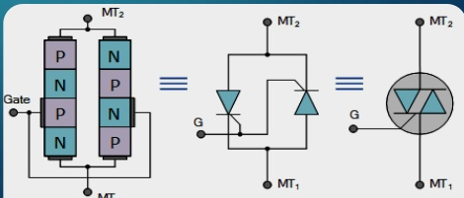
TRIAC
It is a three terminal, five layer device which can control AC current to load
It is a bidirectional device
Typical power rating of TRIAC is nearly 16kW
It is like two SCRs connected anti-parallel

Slide 4
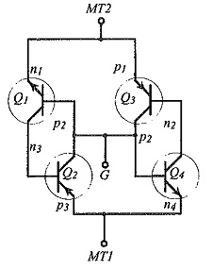
Operation of TRIAC
The transistor equivalent circuit of TRIAC will be composed of four transistor. The transistor Q1 and Q2 constitute the equivalent circuit of SCR1 and transistor Q3 and Q4 constitute the equivalent circuit of SCR2.
When MT2 is positive with respect to MT1 and appropriate gate current is allowed in the gate circuit,SCR1 is turned ON while SCR2 remains OFF. In term of transistor equivalent circuit Q1 and Q2 are forward biased while Q3 and Q4 are reverse biased. Therefore, Transistor Q1 and Q2 conduct current. Since Q1 and Q2 from a positive feedback, both transistor are quickly driven to saturation and a large current flow through the load RL. This is as if switch between MT2 and MT1 were closed.

Slide 5
Operation of TRIAC
When MT2 is negative with respect to MT1 and appropriate gate current is allowed in the gate circuit, SCR2 is turned ON and SCR1 is OFF. In term s of transistor equivalent circuit, Q3 and Q4 are forward biased while Q1 and Q2 are reverse biased. Therefore, transistor Q3 and Q4 will conduct. The current in load RL will quickly attain a large value. The circuit will behave as if a switch is closed between MT2 and MT1.

Slide 6
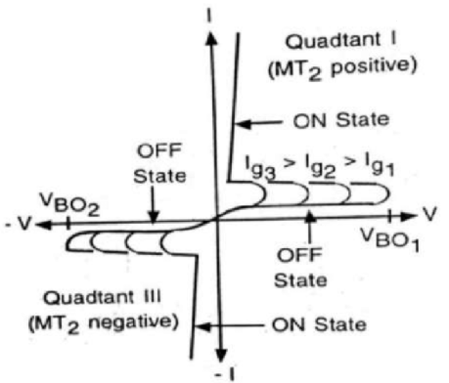
Characteristics of TRIAC

Slide 7
Application Of TRIAC:-
It can operate and switch both half cycles of an AC waveform.
In DC applications, SCRs are required to be connected with a parallel diode to protect against reverse voltage. But the TRAIC may work without a diode, a safe breakdown is possible in either directions.
It can be used as a high power lamp switch
It can be used to Phase Control.

Slide 8
DIAC
Two terminal device
A DIAC is a two terminal, three layer bidirectional device which can be switched from its OFF state to ON state for either polarity of applied voltage.
There is no control terminal on this device.
This device works when avalanche breakdown occurs.

Slide 9
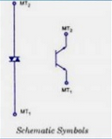
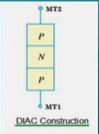
The DIAC can be constructed in either NPN or PNP. Show the basic structure of DIAC in PNP form. The two lead s are connected to p- regions of silicon separated by an n-region.
The structure of DIAC is very much similar to that of a transistor, but there are several important differences:-
i. There are no terminal attached to the base layer.
ii. The three regions are nearly identical in size.
iii. The doping concentrations are identical to give device symmetrical properties.

Slide 10
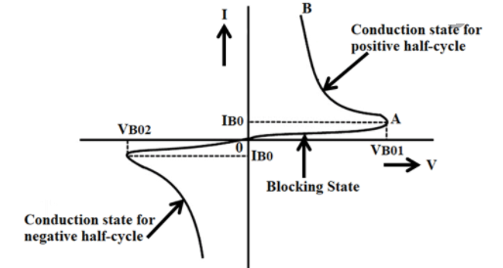
Characteristics of DIAC

Slide 11
Application Of DIAC:-
DIAC are used primarily for triggering of TRIAC.
Light Dimmer
Heat Control

Slide 12
Thank You

